Slide 1
Constructors Of String Class
momedaram

Slide 2
Constructors of String Class, provides many ways to create the string objects.

Slide 3
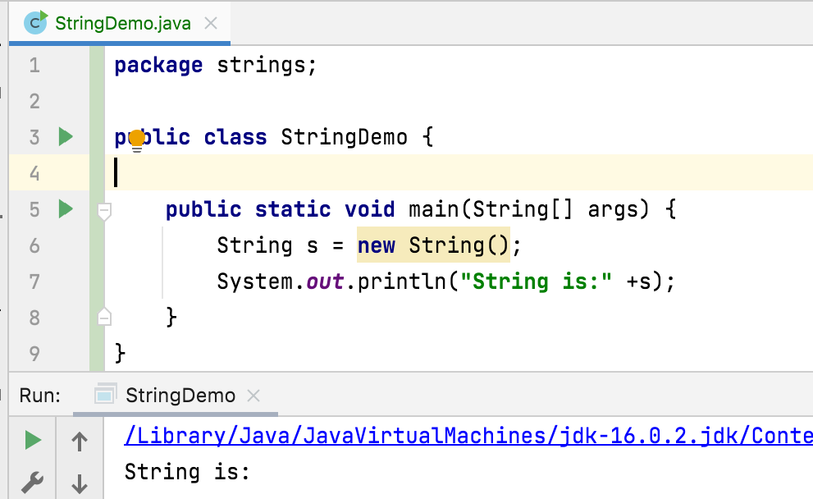
String s = new String();
Creates an empty String object.

Slide 4
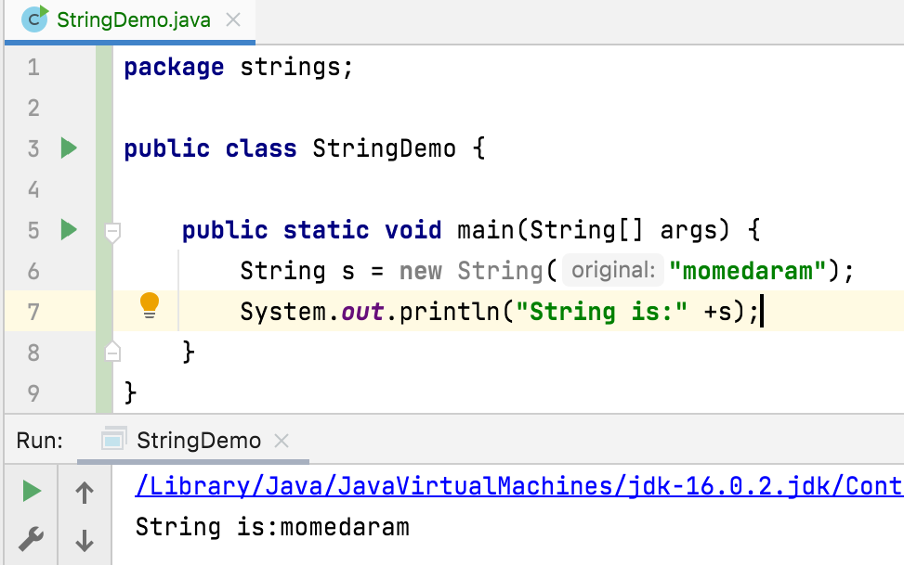
String s = new String(String original);
creates a String object with same sequence of characters as the argument.

Slide 5
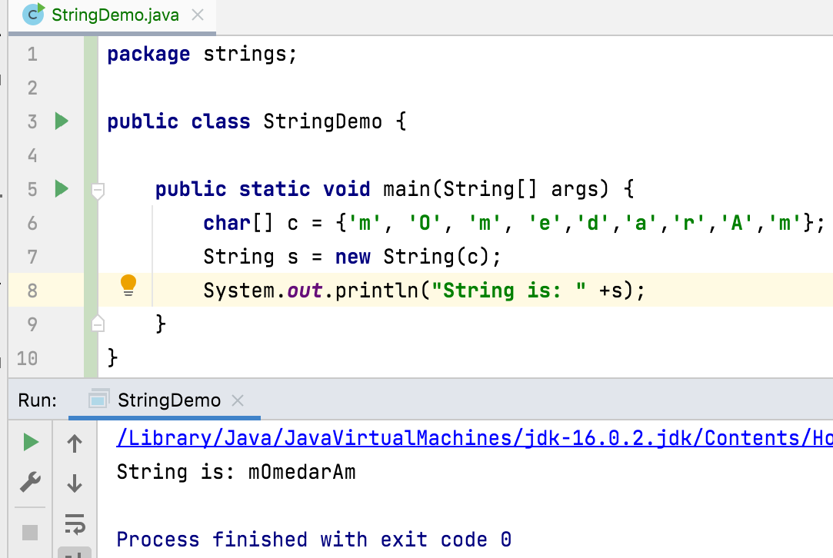
String s = new String(char[] value)
Allocates a new String so that it represents the sequence of characters currently contained in the character array argument. The contents of the character array are copied.

Slide 6
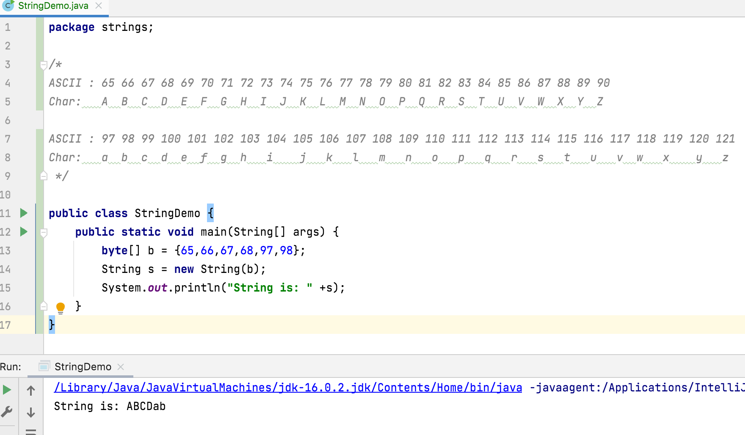
String s = new String(byte[] bytes);
Constructs a new String by decoding the specified array of bytes using the platform's default charset.

Slide 7
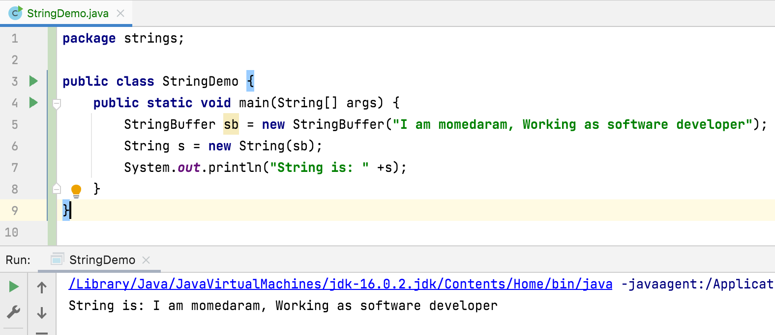
String s = new String(StringBuffer buffer)
Allocates a new string that contains the sequence of characters currently contained in the string buffer argument.

Slide 8
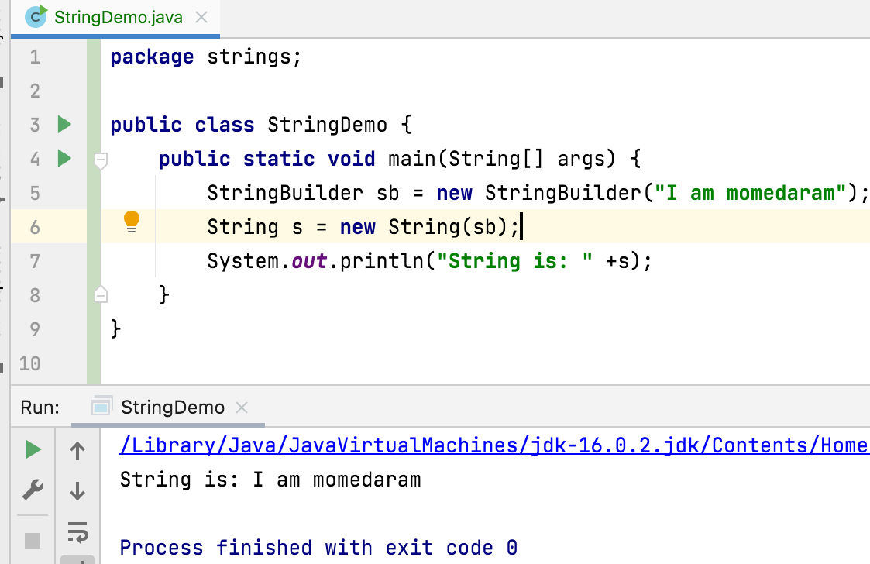
String s = new String(StringBuilder builder)
Allocates a new string that contains the sequence of characters currently contained in the string builder argument.

Slide 9
Thank You !
momedaram

